Slide 1
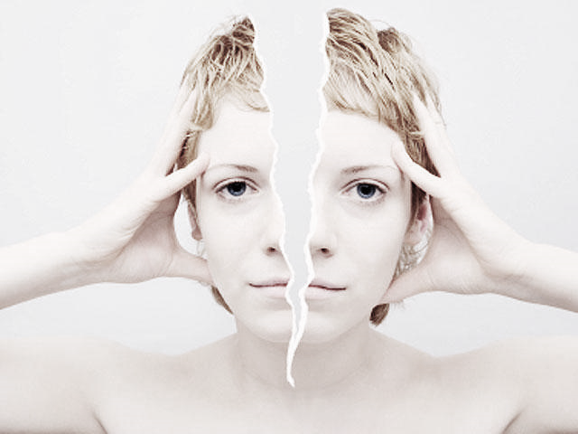
DISSOCIATIVE SEIZURES
— A Medical & Psychiatric Perspective

Slide 2
DOCTOR HAS PSEUDOSEIZURE TO AVOID SEEING PATIENT WITH PSEUDOSEIZURES
“
Dr Weise took one glance at the urine-soaked pants of Ms Wilkins, once again confirming his suspicions about her. The patient grinned whilst rhythmically shaking her arms and rolling her eyes back in her head…
…Dr Weise then collapsed to the ground and pretended to thrash around until he was removed from the scene by his colleagues.

Slide 3
INDUSTRIAL BUILDINGS
TERMINOLOGY
Pseudoepileptic Seizures | Hysterical Seizures | Hysterical Attacks | Non-Epileptic Attack Disorder (NEAD)
Hysteroepilepsy | Dissociative Seizures | Pseudoepileptic Attacks | Pseudoepilepsy
Non-Epileptic Seizures (NES) | Pseudoseizures | Psychoseizures | Psychogenic Non-Epileptic Seizures (PNES)
Functional Seizures | Psychogenic Attacks | Psychogenic Seizures | Non-Epileptic Attacks
Jupiter is a gas giant and the biggest planet in our Solar System. It’s the fourth-brightest object in the sky
Notes:
Many terms add to confusion
I would not want to be diagnosed with psychoepilesy or hysterical attacks!
Pseudo – not real / pretend. Perjorative from outset

Slide 4
INDUSTRIAL BUILDINGS
TERMINOLOGY
Pseudoepileptic Seizures | Hysterical Seizures | Hysterical Attacks | Non-Epileptic Attack Disorder (NEAD)
Hysteroepilepsy | Dissociative Seizures | Pseudoepileptic Attacks | Pseudoepilepsy
Non-Epileptic Seizures (NES) | Pseudoseizures | Psychoseizures | Psychogenic Non-Epileptic Seizures (PNES)
Functional Seizures | Psychogenic Attacks | Psychogenic Seizures | Non-Epileptic Attacks
Jupiter is a gas giant and the biggest planet in our Solar System. It’s the fourth-brightest object in the sky
Notes:
Debate whether to add psychological component in label or not

Slide 5
DISSOCIATIVE SEIZURES
Paroxysmal events that resemble (or can be mistaken for) epilepsy without being associated with abnormal EEG activity or any other primary physiological disturbance e.g. syncope, hypoglycaemia
Somatic manifestation of psychological distress…
Unconscious and involuntary…

Slide 6
Symptom Generation | Unconscious / Involuntary | Conscious / Voluntary
Motivation | Unconscious / Involuntary |  | Conscious / Voluntary
FACTITIOUS
DISSOCIATIVE
MALINGERING
Notes:
Slide shows the spectrum from functional to factitious / malingering
fMRI shows abnormally strong connections between emotion, executive control, movement, and self observation.
fMRI in functional weakness clearly shows totally different pattern to factitious symptoms (frontal not motor).
Having fits in hospital / in front of doctors / willingness to have video-EEG

Slide 7
WHAT IS DISSOCIATION?
A psychologically-mediated alteration in awareness and / or control of neurological function…
Brain becomes overwhelmed and ‘shuts off’ from reality
Often learnt in early childhood
Initially a protective and useful response to escape from intolerable or upsetting thoughts, feelings or memories
Depersonalisation / derealisation
Losing periods of time or memory problems
Blurring of fantasy and reality
Dissociative fugue / seizures

Slide 8
INDUSTRIAL BUILDINGS
EPIDEMIOLOGY
75% Female
Onset
20-40years
Prevalence
2-3 / 10,000
20% of all new epilepsy diagnoses
5-7years
mean delay in diagnosis
75% treated with AEDs by time of diagnosis
30%
of refractory epilepsy
25%
of refractory SE
10-15%
have co-existent epilepsy
High rates of comorbid
Psychopathology

Slide 9
AETIOLOGY
 | Psychological | Social
Predisposing | Childhood trauma History of dissociation Hx somatising and health anxiety - Other MUS Alexithymia ASD (17%) Personality disorder (75-90%) Mood disorder Learning disabilities | Adverse / Abusive childhood experiences Poor family functioning Modelling of attacks on others with epilepsy
Precipitating
Maintaining
Notes:
ASD alexithymia and shutdowns. Often undiagnosed
Personality disorder – diagnosed in 75-90%
Mood disorder – equal to epilepsy
CSA in around 30-50% but also other early childhood trauma
Often FH or close contact with epilepsy

Slide 10
AETIOLOGY
 | Psychological | Social
Predisposing | Acute ‘collapse’ Panic attack Syncope Head injury | Adverse life events but may not be recalled
Precipitating
Maintaining
Notes:
Acute collapse in first attack then DS follows it.
Thoughts / feelings around first attack are key to understanding aetiology. Future attacks are often more habitual. Example.
Adverse life event often triggers the onset but may not be recalled on history taking

Slide 11
AETIOLOGY
 | Psychological | Social
Predisposing | Neural pathway habituation Struggling to accept diagnosis Avoidant / safety behaviours Protective effect of dissociation Triggering dependence | Carers role Fear of responsibilities of being ‘well’ Financial benefits Delayed diagnosis Unclear explanations Inconsistent messages
Precipitating
Maintaining
Notes:
continued belief in organic illness and rejection of psychological component.
safety behaviour due to health anxiety
Carers increase support, provides both patient and carer with a role.
Inconsistent messaging from medics (eg continue your medication – 40% continue AEDs after diagnosis)

Slide 12
CLINICAL FEATURES
Involuntary / unconscious symptom generation
Often in front of witnesses / medical settings
Symptoms of autonomic arousal / panic disorder at seizure onset
Very frequent, often prolonged duration ( > 2 mins )
Abrupt recovery
Ability to recall ictal events
Rapid, shallow, irregular post-ictal breathing c/w deep, regular, stertorous
Lactate, prolactin and CK usually not elevated

Slide 13
COMPARATIVE SEMIOLOGY
Clinical Feature |  | DS | ES
Duration > 2 mins |  | Common | Rare
Recall for period of unresponsiveness |  | Common | Very Rare
Motor Features | Gradual onset | Common | Rare
 | Eyes closed / resistance to eyelid opening | Common | Rare
 | Writhing / violent thrashing movements | Common | Rare
 | Asynchronous (e.g. side-to-side head) movements | Common | Rare
 | Pelvic thrusting | Occasional | Rare
 | Opisthotonus, ‘arc de cercle’ | Occasional | Very Rare
 | Fluctuating ‘waxing and waning’ course | Common | Very Rare
 | Automatisms | Rare | Common
Ictal crying or vocalisations |  | Occasional | Very rare
Cyanosis |  | Rare | Common
Urinary incontinence* |  | Occasional | Common
Injury | Bite injuries to tip of tongue / lips, friction burns* | Occasional | Common
 | Severe tongue biting / lateral border | Very rare | Common
Stereotyped attacks* |  | Common | Common

Slide 14
VIDEOS

Slide 15
Injuries
Seizures ‘during sleep’
Incontinence
Neurological comorbidities esp. LD
PITFALLS IN DIAGNOSIS
Stereotyped attacks
Family Hx of Epilepsy
Notes:
20% have multiple seizure types, during sleep reported in 50% similar proportion to epilepsy but actually occur just after waking

Slide 16
FRONTAL LOBE EPILEPSY
Psychiatric history common
Semiology suggestive of DS
Ictal EEG often normal
Rapid post-ictal recovery common
Pelvic thrusting
Thrashing
Side-to-side head movements
Intense emotional reactions
Bizarre ‘behavioural’ features:
Undressing
Masturbating
Uttering obscenities

Slide 17
DIAGNOSIS
SUSPECT
Frequent / prolonged
Demographics
Risk factors for epilepsy
Refractory epilepsy
PD, PTSD, previous MUS
SEMIOLOGY
Direct observation
Eye-witness account
Video / mobile
SPECIALIST INPUT
Neurology
Psychiatry
Psychology
REVIEW
Previous diagnoses
Investigations
Neurology letters
Collateral history
DIAGNOSTIC TESTS
Prolactin
CK
Lactate
Interictal EEG
Video-EEG Telemetry
Notes:
As with all MUS, if diagnosis made well initially by excluding organic, only 4% later re-diagnosed with an organic problem.

Slide 18
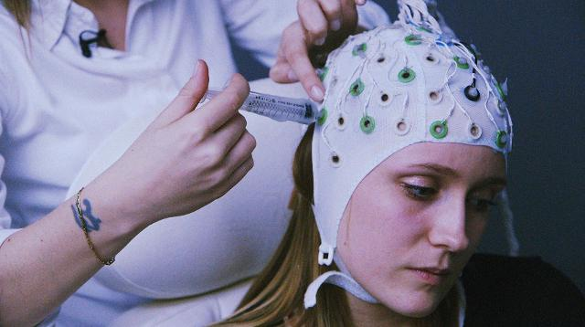
VIDEO-EEG TELEMTRY
Movement artefact may obscure (or be mistaken for) epileptiform discharges
Check with informant that seizure representative of habitual attacks
EEG may be normal in simple partial or frontal lobe seizures
Gold standard investigation for diagnosis
Costly, scarce and limited use if infrequent attacks
Provocation techniques may increase yield
Intact alpha rhythm during seizures / unresponsiveness
Seizure onset during sleep vs ‘pseudosleep’ / after waking

Slide 19
CONFIRM DIAGNOSIS…
Involve senior clinician.
Consider alternative diagnoses.
Ask permission to video attacks?
MINIMIZE DRAMA…
Communicate management plan to all healthcare staff.
Reduce environmental stimulation.
Ensure safety of patient.
ACUTE MANAGEMENT
DON’T RUSH IN…
Take time to observe attacks.
Avoid escalating / repeated doses of benzodiazepines and AEDs.
Reduce iatrogenic harm.
NEXT STEPS…
Present the diagnosis.
Provide information and signpost to other resources.
Arrange neurology and / or psychiatry referrals.
Notes:
25-50% of all SE is DS
Clear instructions and documentation in notes.

Slide 20
01
EXPLANATION of the diagnosis
02
PRESENTING THE DIAGNOSIS
03
04
Only intervention required to stop seizures in 15-30%
Significant reduction in seizure frequency and healthcare utilisation
Avoid prior to specialist assessment if any doubt as to:
Psychogenic nature of seizures
Possibility of co-existent epilepsy
Provide
REASSURANCE
Explain CAUSES and MAINTAINING FACTORS
Explain TREATMENT
and guide EXPECTATIONS
“Possibly the single most important factor in determining outcome.”

Slide 21
01
EXPLANATION of the diagnosis
02
PRESENTING THE DIAGNOSIS
03
04
Reasons for concluding they don’t have epilepsy…
Clinical features of attacks and investigation results.
Provide
REASSURANCE
What they do have…
Define a label.
Explain CAUSES and MAINTAINING FACTORS
Describe Dissociation…
Involuntary, unconscious episodes of ‘switching off’ or ‘going into a trance’.
The brain becomes overwhelmed and ‘shuts down’.
Protective against intolerable emotions or memories.
Explain TREATMENT
and guide EXPECTATIONS

Slide 22
01
EXPLANATION of the diagnosis
02
PRESENTING THE DIAGNOSIS
03
04
They are not suspected of ‘putting on’ their attacks…
Attacks are real, frightening, disabling and involuntary.
Provide
REASSURANCE
The disorder is common…
They are not ‘going mad’.
Explain CAUSES and MAINTAINING FACTORS
Explain TREATMENT
and guide EXPECTATIONS

Slide 23
01
EXPLANATION of the diagnosis
02
PRESENTING THE DIAGNOSIS
03
04
Describe relevant demographic and aetiological factors…
We don’t fully understand what causes this disorder but two-thirds of people with it have suffered the sort of traumatic experiences you have described.
Provide
REASSURANCE
Triggering stresses may not be immediately obvious…
But often become more apparent with treatment.
Explain CAUSES and MAINTAINING FACTORS
Maintaining factors…
Confusion and anxiety about the nature of your seizures, avoidance of certain situations and the protective reactions of your family can create a vicious cycle whereby the fear of having an attack becomes the most important cause of attacks.
Explain TREATMENT
and guide EXPECTATIONS
Notes:
We can’t explain the link for certain, but it may be that when people are exposed to (repeated) traumatic events (during childhood) such as you have described, your brain learns to ‘switch off’. Initially this is a helpful coping strategy as it protects you emotionally at the time. However, this (once adaptive) response may re-emerge later in your life in the face of challenges, stress or reminders of painful memories as these seizures.
You can enquire about previous traumatic events in general but avoid suggesting childhood abuse as a possible aetiological factor unless this emerges spontaneously due to risk of encouraging ‘false memories’
These may turn out to be fleeting stressful thoughts or unpleasant emotions that you were barely aware of (or can’t easily remember) and had little to do with your immediate circumstances. Often more apparent around first event/s before habitual pattern develops.

Slide 24
01
EXPLANATION of the diagnosis
02
PRESENTING THE DIAGNOSIS
03
04
Give hope that their problems are treatable…
Once confusion about your diagnosis is resolved, a significant number of patients find that this explanation alone leads to their attacks become less frequent or stopping altogether.
Provide
REASSURANCE
Many patients can stop taking antiepileptic medications…
Caution that this must be done gradually to prevent withdrawal seizures.
Explain CAUSES and MAINTAINING FACTORS
Explain TREATMENT
and guide EXPECTATIONS
Psychological treatments can help…
To identify triggers, provide coping strategies and reduce the impact of seizures on your quality of life

Slide 25
LONGER-TERM MANAGEMENT
Successful explanation first line
Gradual withdrawal of AEDs (provided no co-existent epilepsy)
Antidepressants only if comorbid depression
Psychological therapy often required for complete recovery
Limited consensus / evidence base for type of psychotherapy
Variety of outcome measures reported
Reduction in seizure frequency ≠ improved QOL or psychosocial recovery
Notes:
Successful explanation may reduce seizure frequency / hopsitalisations BUT does not improve functioning, psychopathology or QOL in the 80% who continue to have DS
Withdrawal of AEDs reduces iatrogenic harm / healthcare utilisation and clarifies diagnosis (for patient and healthcare professionals)
Psychological Rx required for most – unclear which elements of it most help as regardless of type, 30-50% improve in 2yrs.
Can often recover fully once make the shift to understanding the psychological factors
Limited consensus / evidence base due to variety of underlying psychological and psychiatric problems requiring different Rx
Various outcomes re seizure frequency or QOL / adjustment or economic burder / health care usage / iatrogenic harms. Reducing seizure frequency often does not equate to improved QOL or psychosocial recovery
CODES Trial (Lancet Psych) CBT. Does not reduce seizures but reduced distress and better functioning

Slide 26
CODES TRIAL
MERCURY
VENUS
Notes:
Seen by neuro and psych is much better than standard care and both groups improved

Slide 27
LONGER-TERM MANAGEMENT
Potential approaches in psychological therapies…
Understanding why dissociative seizures occur
Identifying potential triggers for attacks and warning symptoms
Learning techniques to control attacks e.g. grounding, breathing, distraction
Exploring stressors and new ways of coping with stress e.g. relaxation, mindfulness
Trauma work
Working on health anxiety as a maintaining factor that limits activities
Increasing activity levels
Working with carers re maintaining factors
Learning how to reduce the impact of attacks / disability
Notes:
Clinical experience (but no evidence): work on increasing awareness that a fit is coming, use grounding / breathing techniques to delay onset of the seizure. Gives patient some control back and ability to get to a safe place before onset. With practise, can lengthen gap significantly and begin to prevent the fits altogether.

Slide 28
Seizure-free after 2y Rx
50%
Continue to have DS
2/3
>1/2
Back on AEDs
Worse Outcomes
Long delay in diagnosis
Failure to accept psychological basis of DS
Psychiatric comorbidity esp. personality disorder
Unemployed or receiving disability benefits
Regardless of type of therapy
PROGNOSIS
After mean follow-up of 3 years
Dependent on social security
After mean follow-up of 3 years
40%
4 years after initial diagnosis

Slide 29
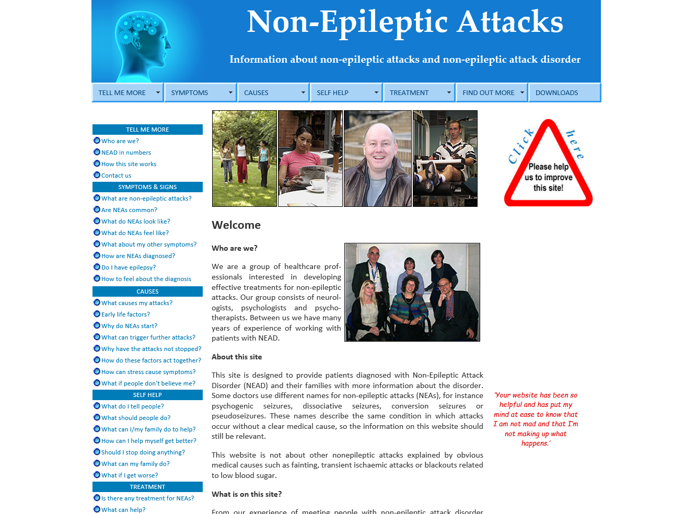
RESOURCES
www.neurosymptoms.org
www.nonepilepticattacks.info

Slide 30
Key Learning
Early diagnosis is critical in improving outcomes
Specific clinical features of attacks may help inform diagnosis but none are pathognomic
Sensitive presentation of the diagnosis is the most important step in management
Neurological & Psychiatric input is essential

Slide 31
Thanks!
Does anyone have any questions?
charlotte.heaps@covwarkpt.nhs.uk

