Slide 1
HIV for Acute Physicians
Dr Helen Dillon
November 2020

Slide 2
What is HIV?
Recognising primary HIV infection
Who to test?
Approaches to;
Fever
Respiratory Illness
CNS symptoms
Adverse reactions to Anti Retroviral Therapy (ART)
Post Exposure Prophylaxis (PEP)

Slide 3
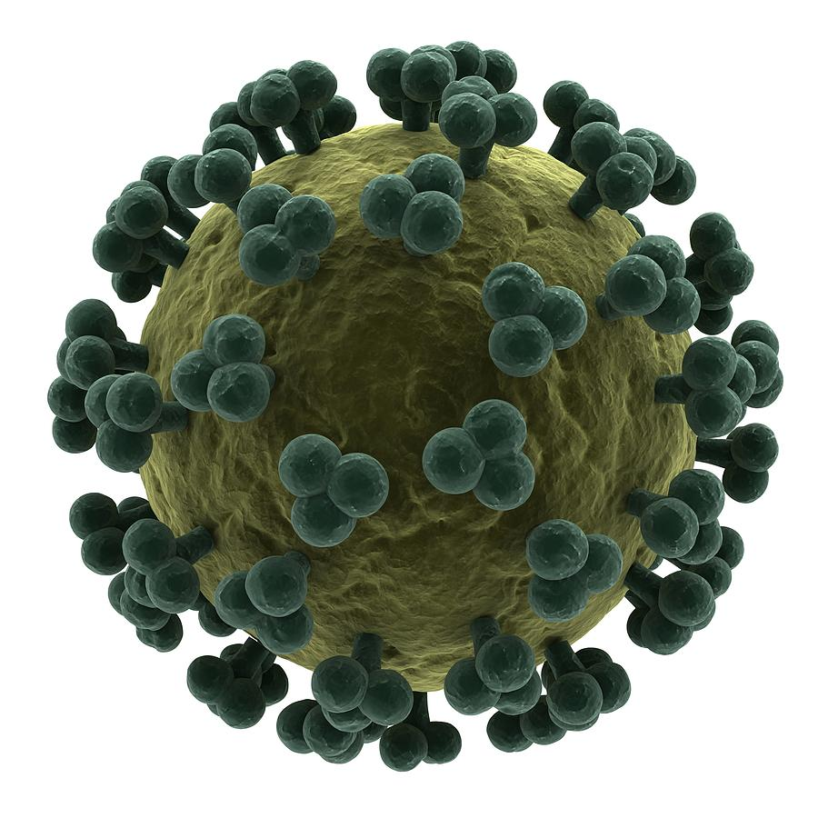
What is HIV?
Human Immune deficiency Virus
Infects CD4+ calls and macrophages
Acquired via contact with infected blood or via sexual contact

Slide 4
HIV
Chronic, manageable disease
Aging population
Elimination of transmission in UK is an achievable goal
Common diseases may present atypically
Opportunistic infections & malignancies are common & may present simultaneously
Acute medics may be the first to consider HIV in the previously undiagnosed
ART can be toxic. Patients may present to acute medicine with side effects. Be very cautious when prescribing anything to patients on ART.

Slide 6
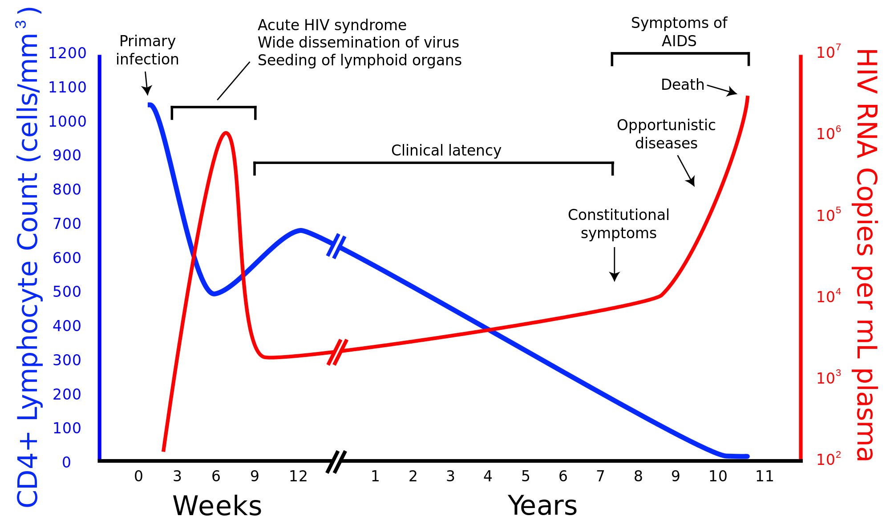

Slide 8
Primary HIV infection (PHI)
PHI (HIV seroconversion illness)
50-70% of HIV infected individuals experience symptoms
Typically within 2-4/52 of exposure but can be up to 3/12
Flu like illness (fever, myalgia, headache, LN, retro-orbital pain)
Maculo-popular rash (similar to secondary syphilis)
Oral/Pharyngeal ulceration or thrush
Genital ulceration or thrush
GI Upset
Splenomegaly (can be tender) – mimics EBV/CMV

Slide 9
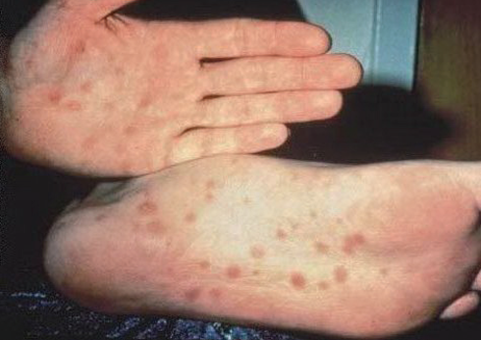

Slide 10
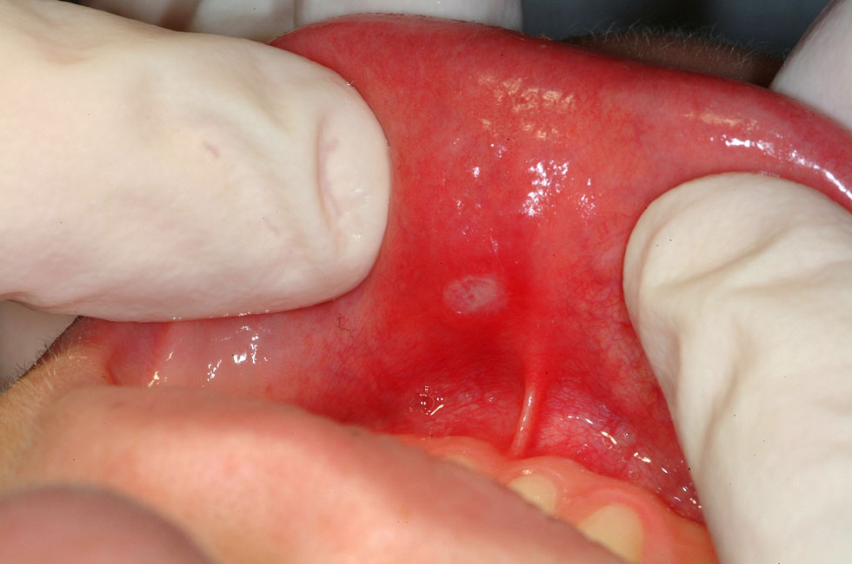

Slide 11
PHI - Investigations
Lymphopenia, thrombocytopenia and raised ALT/AST may all occur
HIV ab may be negative (3rd gen tests usually positive within 60/7, 4th gen tests within 45/7)
HIV RNA will be positive
CD4 may fall transiently to <200 (therefore risk of O.I. Most commonly candidiasis, viral warts, VZV)

Slide 12
HIV Testing

Slide 13
Who to test?
Patients belonging to groups known to have increased risk
men who have sex with men (MSM) and their female sexual partners, IVDU (PWID), sex workers, prisoners, trans women, people from countries with high HIV seroprevalence and their sexual partners;
Patients attending health services whose users have an associated risk of HIV
sexual health services, tuberculosis (TB), hepatitis and lymphoma clinics, antenatal clinics, termination of pregnancy services and addiction and substance misuse services;
Patients presenting with symptoms and/or signs consistent with PHI or a HIV indicator condition;
Patients accessing healthcare in areas with high (>2/1000; if undergoing venepuncture) and extremely high (>5/1000; all attendees) HIV seroprevalence;
Sexual partners of an individual diagnosed with HIV.

Slide 14
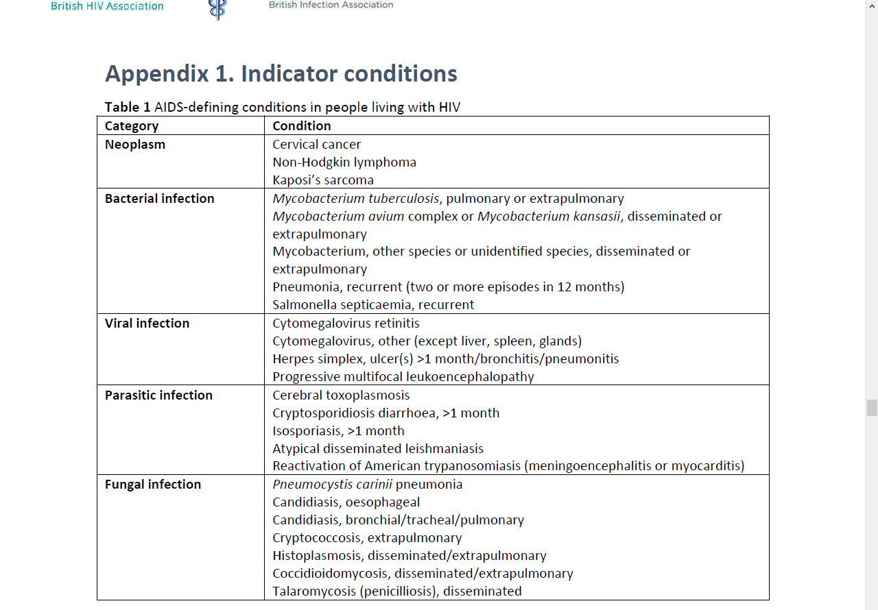

Slide 15
HIV indicator conditions where HIV test is recommended, defined by having an undiagnosed HIV prevalence of at least 1 per 1000
Herpes Zoster
Community Acquired Pneumonia
Mononucleosis-like illness (GF)
Unexplained leukocytopenia/thrombocytopenia for >4 weeks
Seborrhoeic dermatitis
Peripheral neuropathy
Unexplained weight loss
Oral candidiasis
Primary lung cancer
Chronic diarrhoea
Unexplained CKD

Slide 16
Overcoming barriers to testing
Any doctor, nurse or other health professional should be competent to offer an HIV test.
• An opt-out HIV testing approach should be adopted where appropriate in order to address some of the barriers to HIV testing.
• Education and training should be provided to all healthcare workers who may be expected to act on these guidelines.
• The offer of an HIV test should be integrated into routine practice to normalise HIV testing).

Slide 17
Testing without consent
Permitted in these circumstances;
In the confused/unconscious patient where HIV infection is suspected and if found would alter the management of the patient
Following a needlestick injury, testing of an unconscious/confused ‘donor’ is justified only if the patient is unlikely to regain consciousness for >48 hours and if testing can be undertaken on a previously taken blood sample. Always inform trust legal team/medical defence organisation.

Slide 18
Remember…..
Unrecognised infection is common
Especially in women & older people
Some patients will not disclose (or may deny) their status
Always include an assessment of HIV risk factors (travel, sexual history, IVDU) when assessing a patient with a presentation suggestive of infection

Slide 19
Presentations to Acute Medicine
Fever
Respiratory Presentations
Neurological presentations
Reactions to ART

Slide 20
Approach to Fever in known/suspected HIV + patient
Bacterial
S.pneumoniae
M.TB
MAI
Viral (including HIV itself)
EBV/CMV/VZV/HSV
Fungal
Cryptococcus
Protozoal
PCP
Malignancy
Lymphoma
Drug Related

Slide 21
Fever
Whats the CD4?
>250 – treat as you would a HIV - patient (unless recently started on ART – consider ART toxicity or IRIS)
<250 – Consider O.I
If clinical evidence of sepsis start antibiotics and ‘sepsis 6’ immediately. Otherwise look for source.
Thorough clinical examination
Oral/Genital ulceration or candidia, Lymphadenopathy, Organomegaly, Rash
Always do ENT examination, full neurological examination (including fundoscopy) and look at genitals

Slide 22
Fever & CD4 <200
Usual Investigations for Fever of unknown source
Plus
Mycobacterial Cultures if CD4 <100
Cryptococcal Antigen (CRAG) if CD4 <50
Tropical pathogens as per travel history
C.America, Eastern USA: Histoplasmosis
S.America, SW USA: Coccidiomycosis
SE Asia, Indonesia: Penicillinosis
Tropics: Strongyloides
Mediterranean, Tropics:Leishmaniasis
Subsaharan Africa, India: Schistosomiasis
Low threshold for CT head/LP if any headaches, drowsiness, neurological symptoms/signs

Slide 23
Fever
If source not identified after ‘first line’ tests
TTE
CT head/LP
CT T/A/P
Bone Marrow
Lymph node biopsy

Slide 24
Immune Reconstitution Syndrome (IRIS)
An inflammatory response to pre-existing infections
Infections may be previously known and treated or may be unmasked by the patients new ability to mount a response
Debate surrounds best timing of ART once treatment of an O.I is initiated
Variable clinical features (depending on the underlying infection)
Can develop from 7 days up to many months after starting ART
ART should always be continued (unless IRIS is life or organ threatening).
Steroids are often useful (prednisolone 60-80mg OD, tapered over weeks-months)

Slide 25
Approach to Respiratory Presentations
Always have high index of suspicion for M.TB – Side room.
Beware ‘normal’ CXR’s – history is most important
Whats the CD4? – if <200 & history compatible – treat empirically for PCP
Cough
Purulent sputum – bacterial pneumonia (H.influenza, S.pneumoniae) or M.TB most likely
HIV + are often AAFB negative (even with very abnormal CXR)
Non productive cough – if CD4 <200, PCP is biggest concern. Can also occur as part of PHI.
Heamoptysis – M.TB, MAI, Fungal, KS
SOB
If sudden onset consider ACS (HIV is risk factor) or pneumothorax (secondary to infections including PCP)
If gradual & progressive and CD4<200 – PCP
Chest Pain – HIV + patients are at greater risk of both IHD and thromboembolic disease

Slide 26
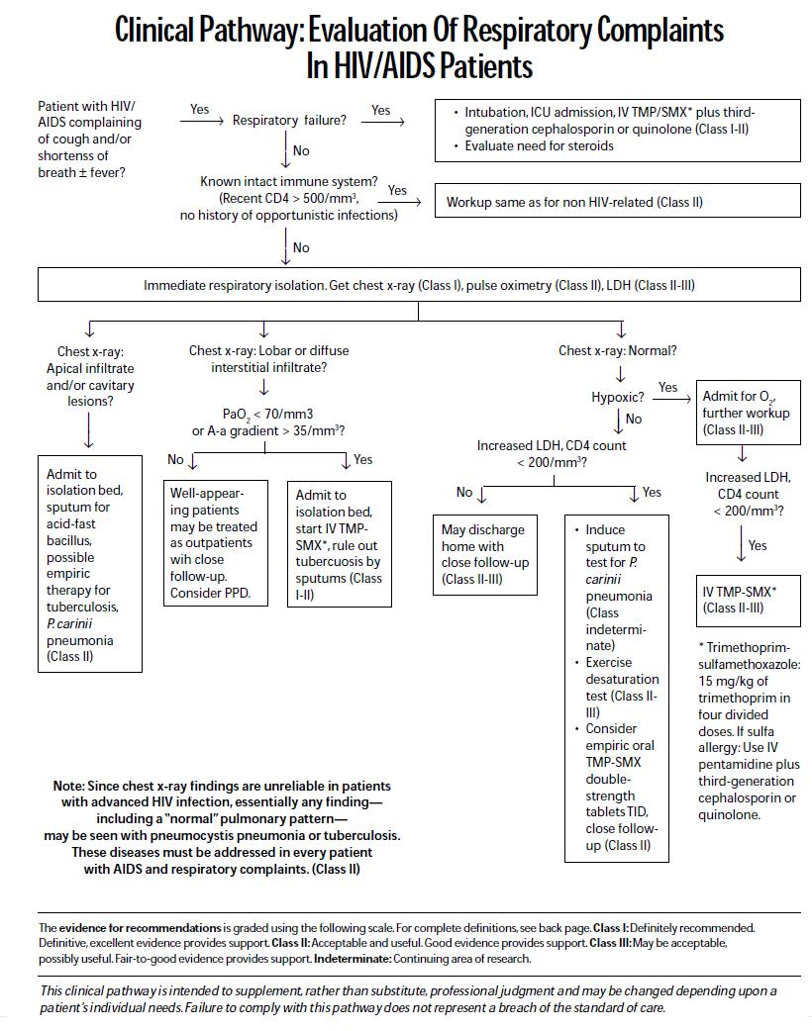
If PaO2 <8.0kpa add Prednisolone 75mg OD PO for 5/7, then 50mg OD for 5/7, then 25mg OD for 5/7

Slide 27
PCP
Pneumocystis jirovecii pneumonia (previously pneumocystis carinii)
Most common AIDS defining OI
Typically when CD4<200
Symptoms include fever, dry cough, night sweats, SOB (progressive)
Typical CXR appearance – B/L ground glass shadowing
Diagnosis is by detection of organism in induced sputum or BAL
Treatment is with trimethoprim/sulfamethoxazole (TMP/SMX)

Slide 28
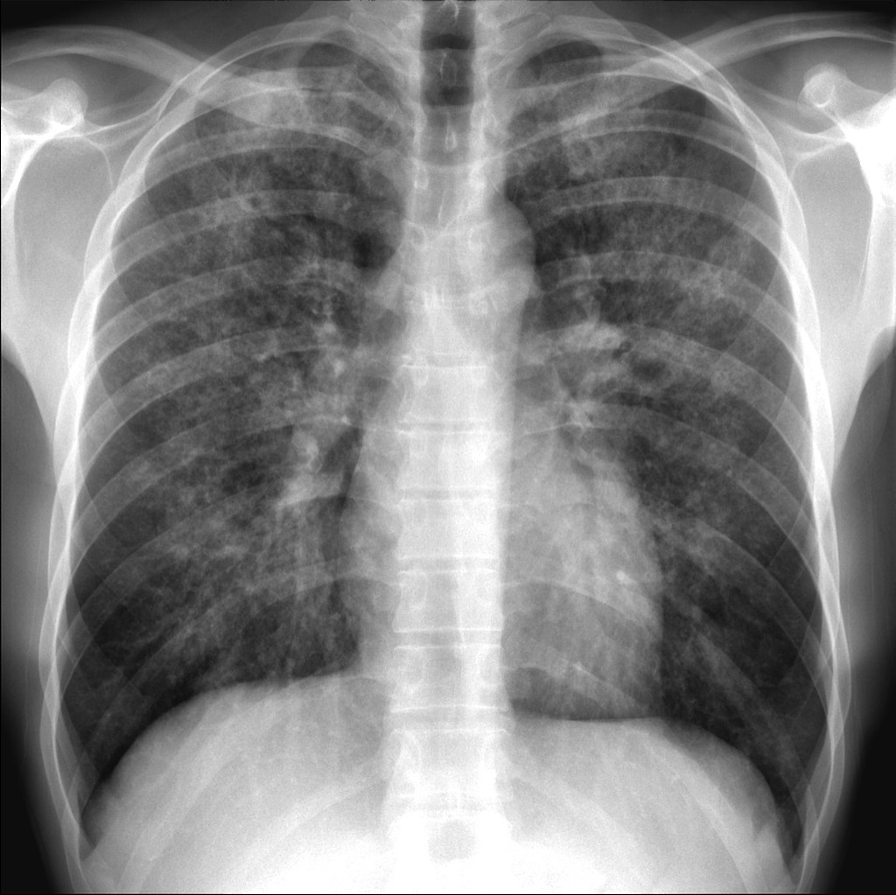

Slide 29
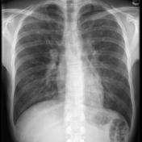
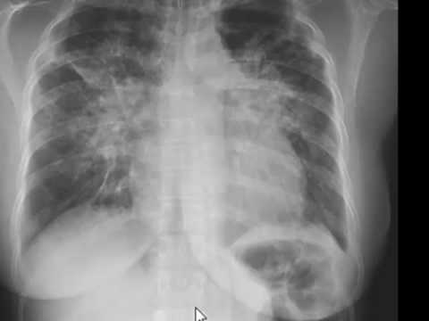

Slide 30
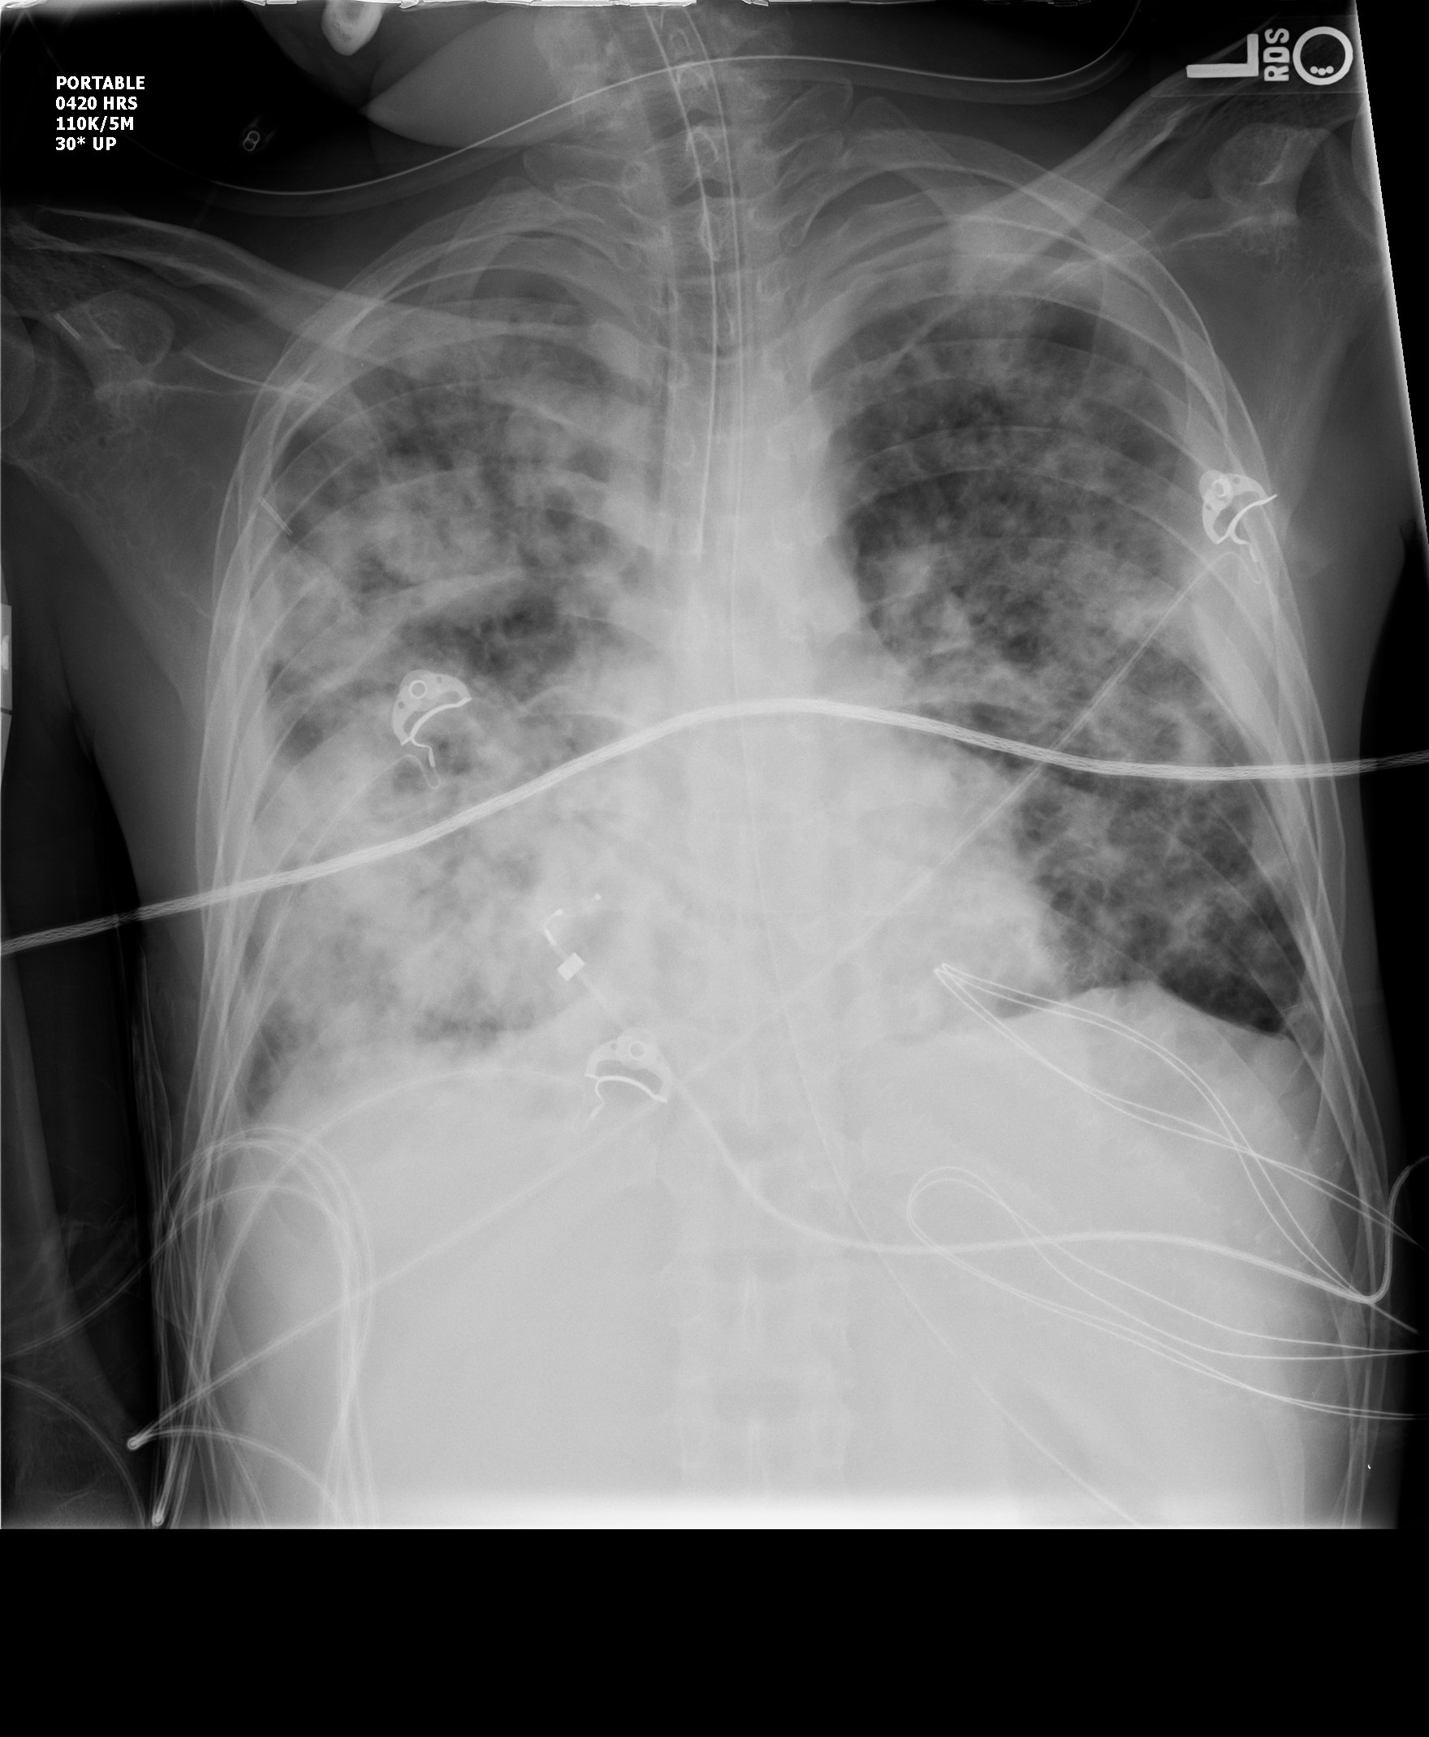

Slide 31
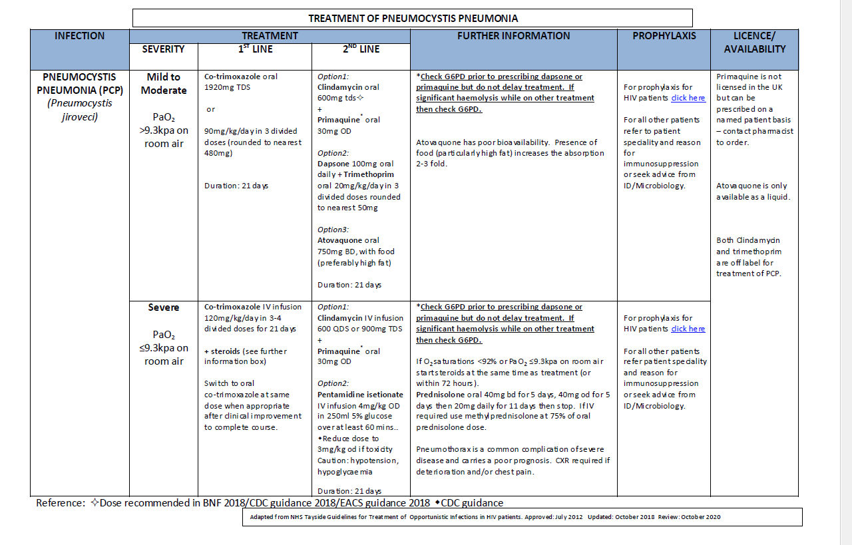

Slide 32
Approach to Acute Neurological Presentations
Seizures – be aware of drug interactions. Lorazepam preferable to diazepam. Valproate is best anti-epileptic if on a PI
Headache – Low threshold for CT/LP if low CD4
Meningism – May be reduced/absent due to impaired inflammatory response. Aseptic meningitis can occur with PHI. In advanced immunosuppression viral, bacterial, tuberculous, cryptococcal and fungal CNS infections are all common and rarely manifest with typical signs of meningism
Paraparesis – Consider viral transverse myelitis (HIV, CMV, VZV, HSV) or cord compression sec to infection (abscess….often TB) or malignancy.

Slide 33
Acute Neurology….
Cognitive Impairment – If associated with focal neurological signs consider SOL (Toxo, TB), PML. Also HIV dementia, late syphilis
Psychiatric Disturbance – Consider interaction between ART and recreational drugs
Visual Deterioration – CMV retinitis, Toxoplasma, TB

Slide 34
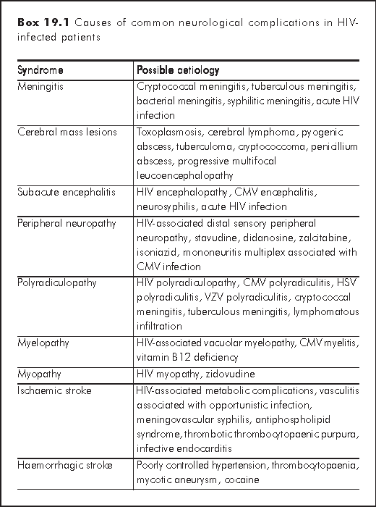

Slide 35
Acute neurology – extra investigations
Bloods
CD4, RNA, Toxo serology, CRAG, CMV and EBV serologies (and PCR if CD4,100), Syphillis (TPHA)
Blood cultures (including mycobacterial if CD4<100)
CSF
ALWAYS image before LP
When sending CSF always take a large (20 drops) 4th bottle for virology. Allows extra for additional virology tests. Request ‘save sample’ for any remaining.
PCR for CMV, HSV, VZV, JC virus, EBV, CRAG
Send further sample for cytology if lymphoma suspected

Slide 36
Imaging
Contrast Essential
MRI more sensitive than CT
CT can miss brainstem disease (TB), Toxo cysts, PML
‘Ring enhancing lesions’
Toxoplasmosis
Typically multiple with associated odema in BG
Lymphoma
Fewer lesions. Irregular enhancement. Periventricular odema
TB, Bacterial abscess, cryptococcoma
Meningeal enhancement & Hydrocephalus
TB, Cryptococcal, Syphillis
PML
Non enhancing, multifocal, sub-cortical white matter changes

Slide 37
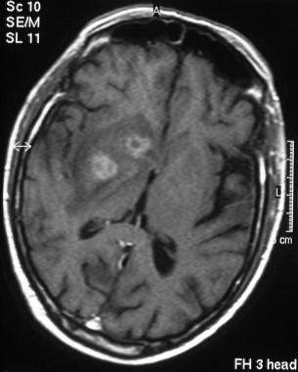

Slide 38
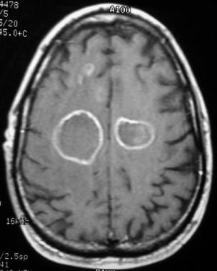

Slide 39
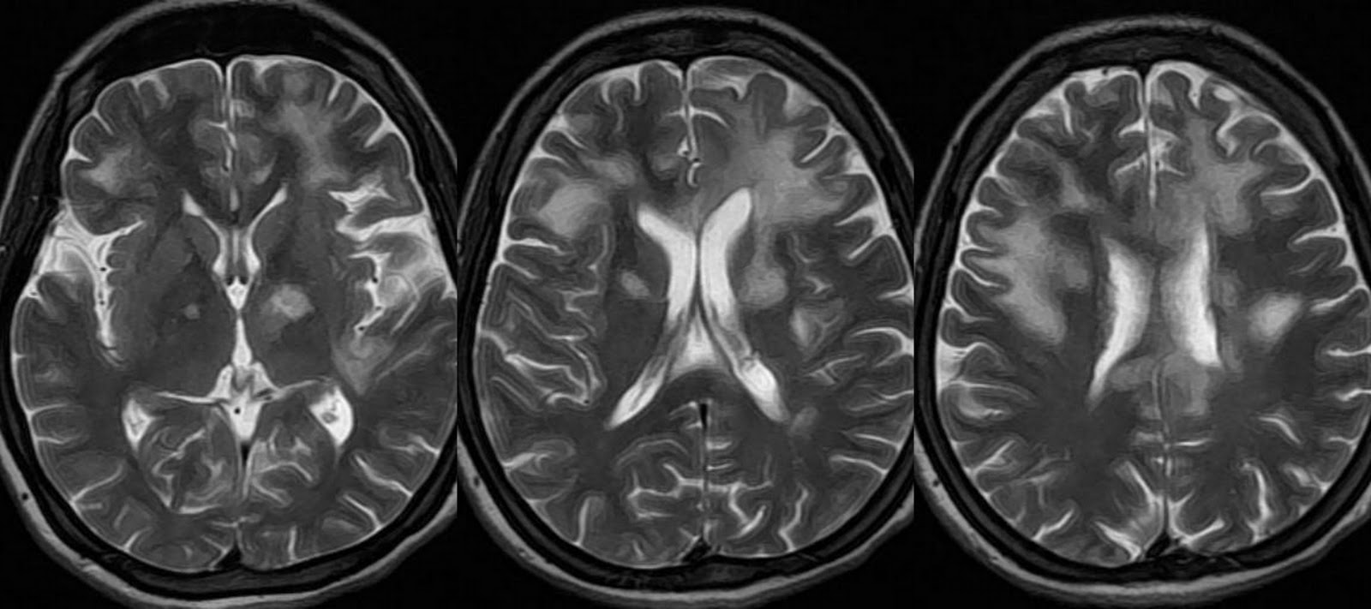

Slide 40
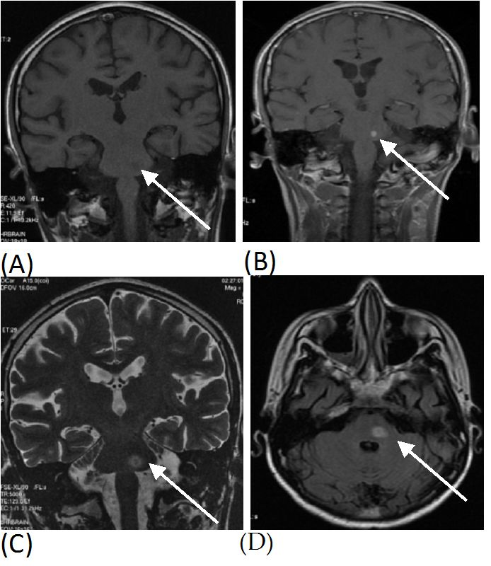

Slide 41
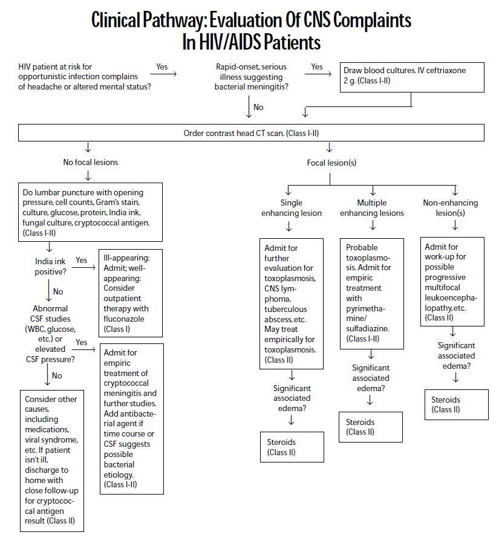

Slide 42
First Line Treatments
Cerebral Toxoplasmosis
Sulfadiazine (1000 mg four times daily among patients <60 kg or 1500 mg four times daily among patients ≥60 kg
Pyrimethamine (200 mg loading dose followed by 50 mg daily among patients <60 kg or 75 mg daily among patients ≥60 kg).
Cryptococcal Meninitis
liposomal amphotericin B (3 to 4 mg/kg intravenously [IV] daily) plus flucytosine (100 mg/kg per day orally in four divided doses) for a minimum of two weeks, followed by consolidation therapy with fluconazole at a dose of 400 mg orally once daily for a minimum of eight weeks.
CNS TB
Rifater plus Ethambutol (Moxifloxacin if cant get VA). Plus Prednisolone 60-80mg OD (Dexamethasone if significant odema or unable to take oral medication)

Slide 43
Antiretroviral Toxicity
Rash
Abacavir hypersensitivity can present as fever and/or maculopapular rash (usually during first 2/12 of treatment). May also present with fever, sore throat, GI upset, Respiratory Symptoms). If strongly suspected Abacavir should be stopped (discuss with GU physician). Should be rare as patients should be tested for HLAB5701 pre treatment to predict risk.
NNRTIs (Efavirenz, Nevirapine) cause a maculopapular rash in ~10%, peaking at 2/52 and often associated with abnormal LFTs. Most patients can ‘push through’ with antihistamines and close monitoring.
Stevens-Johnson and TEN can occur with any ART but are more common with Nevirapine (especially if started at CD4 >250 in women or >400 in men)

Slide 44
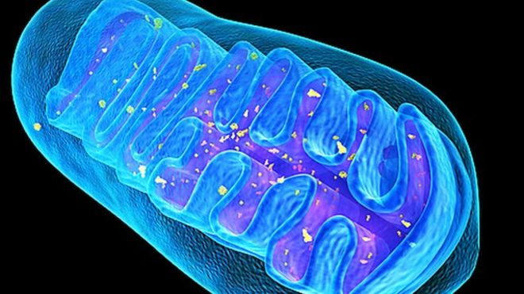
Antiretroviral Toxicity
Mitochondrial Toxicity
Consider in any patient on an NRTI who presents systemically unwell. Send immediate Lactate and check Amylase
Caused by unwanted inhibition of mitochondrial DNA by NRTI’s (especially stavudine & didanosine). Over months mitochondrial dysfunction can manifest as;
Lactic acidosis – Lactate often >5.0. Malaise, Abdo pain, Metabolic Acidosis, Deranged LFTs
Pancreatitis
Myopathy
Peripheral Neuropathy

Slide 45
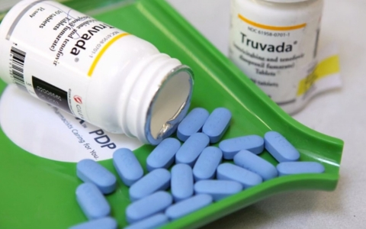
Antiretroviral Toxicity
Metabolic Disturbances
Glucose intolerance – Protease Inhibitors
GI upset/diarrheoa – Protease Inhibitors. Usually resolves after first 4/52
Heamatological Toxicity
Anaemia/Neutropenia – AZT
Hepatotoxicity
All ART (don’t generally discontinue unless >5x upper limit of normal)
Fulminant Hepatitis – Nevirapine
Hyperbillirubinaemia – Atazanavir
Neurological Toxicity
Efavirenz – mood swings, depression, sleep disturbance, nightmares. Often improves after first 4 weeks. Up to 50% will persist to some degree.

Slide 46
Post Exposure Prophylaxis (PEP)
Risk assessment (discuss with physician on call for PEP)
Risk of HIV Transmission from a needlestick is 1 in 300 (<1 in 1000 from a splash injury)
Risks from sexual contact (estimates)
Unprotected vaginal sex (m to f or f to m) 1 in 1000
Unprotected anal sex (risk to insertive partner) 1 in 1000
Unprotected anal sex (risk to receptive partner) up to 1 in 30
Consider the likelihood of the donor being HIV + (if unknown/cant be tested). E.g Risk of an IVDU being + is around 5%, Individuals from certain areas in Subsaharan Africa may have a risk as high as 20-50%)
If felt appropriate PEP/PEPSI should be initiated ASAP (always within 72 hrs)
Triple therapy (usually Tenofovir, Emtricitabine and a Protease Inhibitor)
Significant side effects

Slide 47
PREP (Pre-exposure prophylaxis)
Medication taken by high risk patients to prevent HIV
Most commonly Truvada
Highly effective for preventing HIV.
• Reduces the risk of getting HIV from sex by about 99% when taken as prescribed.
•Less information about how effective PrEP is among people who inject drugs - reduces the risk of getting HIV by at least 74%
•PrEP reaches maximum protection from HIV for receptive anal sex at about 7 days of daily use.
•For receptive vaginal sex and injection drug use, PrEP reaches maximum protection at about 21 days of daily use.
•No data are available for insertive anal sex (topping) or insertive vaginal sex.

Slide 48
Summary
Chronic manageable condition
Patients will present acutely with both primary infection and complications of chronic infection.
You wont find it if you don’t look for it!!
Management is often best guided by a knowledge or estimate of the patients CD4.
ART has significant side effects, toxicities and interactions.
ART should always be continued in in-patients. If this isn’t possible this should always be discussed (urgently) with the GU/ID on call.
Changes in ART should always be discussed with GU Physician on call.

Slide 49
The End

