Slide 1
Dizziness | Vertigo Tom Heaps Consultant Acute Physician

Slide 2
What is Dizziness?
Panicky
Fuzzy-head
Dizzy
Off-balance
Giddy
Light-headed
Unsteady
Room spinning
Faint
Vertigo

Slide 3
How common is dizziness in the elderly?
Increased risk of falls and fractures
Reduced participation in exercise, social activities and driving
Loss of independence
Decreased quality of life
Marsingh et al. Dizziness reported by elderly patients in family practice: prevalence, incidence, and clinical characteristics. BMC Family Practice 2010; 11:2

Slide 4
The Dizzy Tree
Dizziness
False sense of motion or sensation of spinning
Light-headed or about to ‘pass out’
Off-balance or ‘wobbly’
Vertigo
Presyncope
Dysequilibrium
Single vs Recurrent Attacks
Postural
Orthostatic Hypotension
Vasovagal
Non-Postural
Cardiogenic
Anxiety
Neurological Disorders
MFDE (Multifactorial Dizziness in the Elderly)
Medication-related
Chronic BPPV
Uncompensated Vestibular Disorders
Peripheral vs Central Causes

Slide 5
Vertigo
‘an illusory sensation of movement’
- mismatch between visual input and sensory information from the vestibular labyrinths
- abnormal central processing of vestibular input (brainstem vestibular nuclei / cerebellum)
Rotational
Swaying
Rocking
Tilting
Translational

Slide 6
Classification of vertigo 1
Peripheral | vs | Central
Vestibular apparatus and vestibular nerve |  | Brainstem vestibular nuclei and cerebellum
Benign Paroxysmal Positional Vertigo (BPPV) Vestibular Neuronitis Meniere’s Disease Acoustic Neuroma Herpes Zoster Oticus (Ramsay-Hunt Syndrome) Aminoglycoside Toxicity |  | Migrainous Vertigo Posterior circulation stroke Posterior fossa SOL Multiple Sclerosis

Slide 7
Classification of vertigo 2
Time Course | Cause | Duration of symptoms
Single Attack | Vestibular neuronitis | Hours to days
 | Posterior circulation stroke | Hours to days
Recurrent / Episodic Attacks | BPPV | Brief (seconds to minutes)
 | Migrainous Vertigo | Minutes to days
 | Meniere’s Disease | Minutes to hours (<24)

Slide 8
Common causes of vertigo
Cause | % of all Vertigo in Primary Care | % of all Vertigo in Specialist Clinics
BPPV | 40% | 10-27%
Vestibular neuronitis | 40% | 10-44%
Migrainous Vertigo | 14% | 7-10%
Meniere’s Disease | <1% | 3-11%
POCS | Unavailable | Unavailable
Barraclough K and Bronstein A. Vertigo. BMJ 2009; 339: 749-52

Slide 9
Clinical Case 1
52-year-old male with type 2 diabetes and hypertension
Admitted with 12h history of vertigo / vomiting and mild headache
Recent coryzal symptoms
No previous attacks of vertigo
No associated neurological symptoms, hearing loss or tinnitus
No history of migraine
WHAT ELSE DO YOU NEED TO KNOW?
WHAT TESTS DOES HE REQUIRE?
WHAT IS THE MOST LIKELY DIAGNOSIS?

Slide 10
Central vs. Peripheral
 | Peripheral Lesion | Central Lesion
Nystagmus
Direction | Unidirectional – fast phase always away from affected ear | Bidirectional – direction of fast phase reverses with gaze towards opposite side
Type | Horizontal or horizontal-torsional | Vertical, horizontal or torsional
Effect of Visual Fixation | Suppressed | Not suppressed
Head Impulse Test | Positive (abnormal) | Negative (normal)
Other Neurological Signs | Absent | Usually present (except midline cerebellar stroke)
Postural Instability | Unidirectional, walking preserved | Severe, patient often falls
Deafness / Tinnitus | May be present | Usually absent (unless AICA stroke)

Slide 11
Red Flags in Vertigo
Age (>40) especially if vascular risk factors
Headache +/- hypertension
ANY associated neurological symptoms / signs (including severe ataxia)
Abnormal eye movements or atypical nystagmus – HINTS
Acute hearing loss (AICA infarction)
Prolonged (severe) symptoms >4d
= NEUROIMAGING

Slide 12
Vertigo - HINTS
Head Impulse test negative (i.e. ‘normal’ response)
Nystagmus suggestive of central lesion
Test for Skew deviation positive (vertical movement of eye after uncovering)
≥1 of above suggests central lesion (often POCS) with sensitivity approaching 100% and specificity 96%

Slide 13
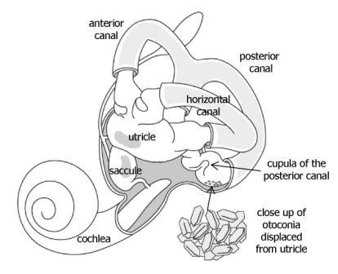
BPPV
affects almost 1:10 older people, women 2x men
displacement of otoconia (otoliths) from utricle / saccule into semicircular canals
usually idiopathic (age-related vestibular membrane degeneration)
may occur after minor head trauma or other vestibular insults
brief episodes of vertigo ≤ 60 seconds
precipitated by certain head movements
looking upwards (posterior canalithiasis) e.g. hanging out the washing
turning over in bed (horizontal canalithiasis)
recurrent episodes over weeks to months
more persistent dysequilibrium may occur in chronic cases

Slide 14
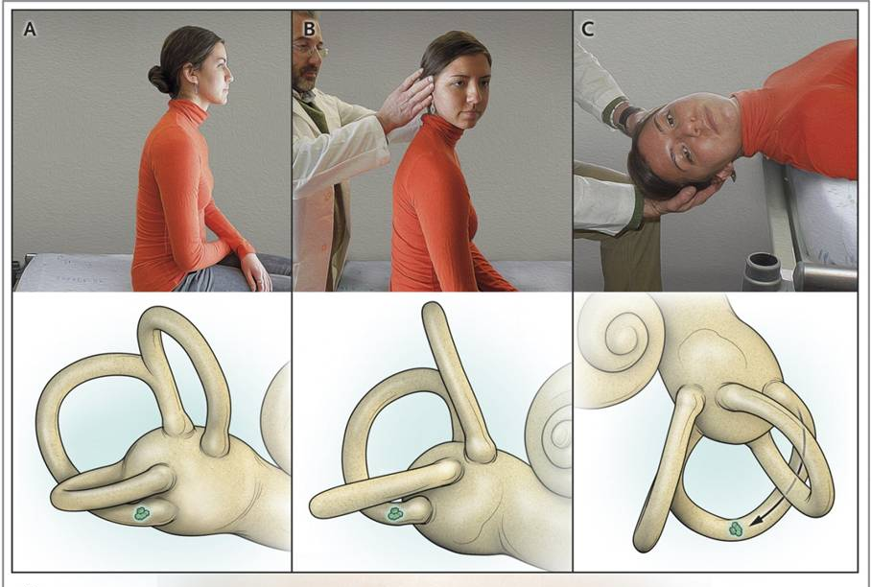
BPPV: Diagnosis – Dix-Hallpike
patient sitting, extend neck and turn to one side
patient then placed rapidly supine with head hanging over edge of bed at 30° to horizontal
observe patient for 30 seconds for nystagmus
appears with latency of a few seconds and lasts < 30 seconds
typical trajectory beating upward and torsionally, with upper poles of eyes beating toward the ground
recurs in the opposite direction on sitting the patient up
intensity and duration decreases with each repetition to the provoked side i.e. fatiguability
if nystagmus is not provoked, repeat manoeuvre with head turned to the opposite side

Slide 15
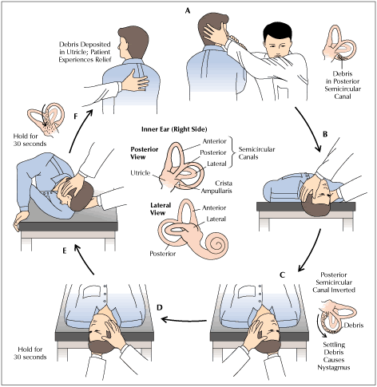
BPPV Treatment – Epley Manouevre
particle repositioning manoeuvre - encourages debris to move back into the utricular cavity
single manoeuvre effective in 85% of patients
modified manoeuvres (Lempert roll, Gufoni) for anterior / horizontal canalithiasis
up to 1/3 have vague imbalance and dizziness for 2-3 weeks after successful treatment
postural restriction (cervical collar / upright posture) for 2 days?
vestibular suppressants for 1 week?
35% recurrence rate at 5 years
more likely if older with chronic symptoms

Slide 16
Vestibular Neuronitis / Neuritis
Viral or post-viral inflammation of the vestibular nerve
50% report preceding viral infection (URTI); causative agent unknown
Acute onset sustained vertigo (often present on waking)
Nausea, vomiting, gait instability (veering towards affected side)
Labyrinthitis only if associated hearing loss
Examination consistent with unilateral peripheral vestibular insult
spontaneous unidirectional nystagmus (fast phase away from affected side)
positive (abnormal) head impulse test
NO other neurological symptoms or signs
Rx oral steroids and short-term vestibular suppressants (lorazepam, prochlorperazine, cyclizine)
Gradual resolution of symptoms over 24-48h
residual imbalance and nonspecific dizziness may persist for months

Slide 17
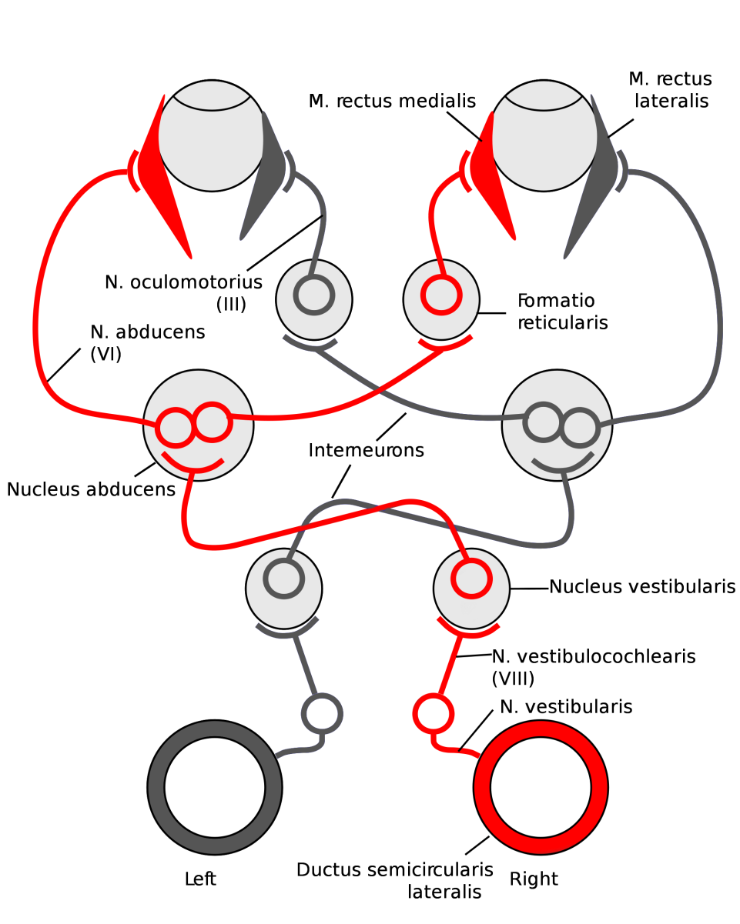
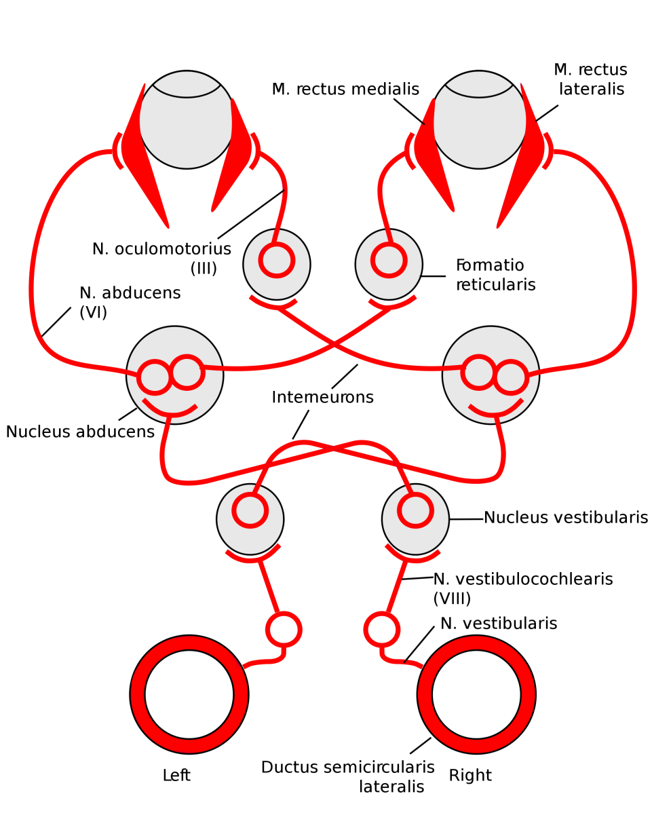
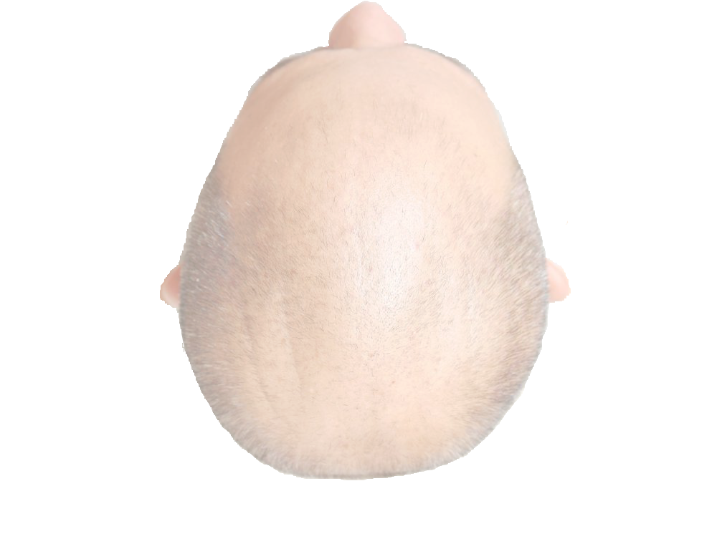
In the resting state, low-level baseline activity from both vestibular systems stimulates medial and lateral recti on both sides equally, maintaining forward gaze
Vestibular output from the unaffected (right) side is now unopposed and the brain misinterprets this as if the head is turning towards the right…
…causing activation of the left lateral rectus and right medial rectus, effected by the intact vestibular system; the eyes are slowly dragged off target to the left (the pathological component of nystagmus)
With a unilateral peripheral vestibular lesion, vestibular activity from the affected (left) side ceases….
There is then a rapid corrective movement of the eyes to the right (fast phase of nystagmus away from the side of the lesion) back into the midline

Slide 18
Meniere’s Disease
Idiopathic endolymphatic hydrops; aetiology unclear
Prevalence 0.1-0.2%, usual onset age 20-40 years (may occur at any age)
Episodic attacks of vertigo / vomiting lasting minutes to 24h
May be preceded by sensation of aural fullness
Progressive sensorineural hearing loss (initially low-frequency / fluctuating)
Low-frequency tinnitus
Tumarkin’s otolithic crises (drop attacks) may occur with chronic disease
Examination consistent with unilateral peripheral vestibular insult
Need to exclude acoustic neuroma (MRI internal auditory meatus)
Becomes bilateral in 1/3 of cases, BPPV occurs in 40%

Slide 19
Meniere’s Disease - Treatment
Rx acute attacks with short-term vestibular suppressants
Lifestyle modification
decrease salt intake (2-3g sodium per day)
reduce consumption of alcohol, caffeine, nicotine
Chronic therapy with bendroflumethiazide and / or betahistine (Serc®)
Surgical options
destructive (intratympanic gentamicin, labyrinthectomy, vestibular neurectomy)
non-destructive (endolymphatic sac decompression / shunting or sacculotomy)

Slide 20
Posterior Circulation Stroke (POCS)
Acute onset sustained vertigo lasting hours to days
Suspect if age >40 and / or vascular risk factors (or any other red flags)
Associated neurological symptoms / signs (except midline cerebellar stroke)
diplopia (ophthalmoplegia), dysphagia, dysarthria,
focal unilateral / bilateral motor /sensory deficits
crossed syndromes e.g. lateral medullary syndrome
homonymous hemianopia, pupillary abnormalities (e.g. Horner’s)
syncope or altered conscious level
Severe postural instability / truncal ataxia
Examination consistent with central cause for vertigo
MRI with DWI +/- MRA/CTA are the investigations of choice

Slide 21
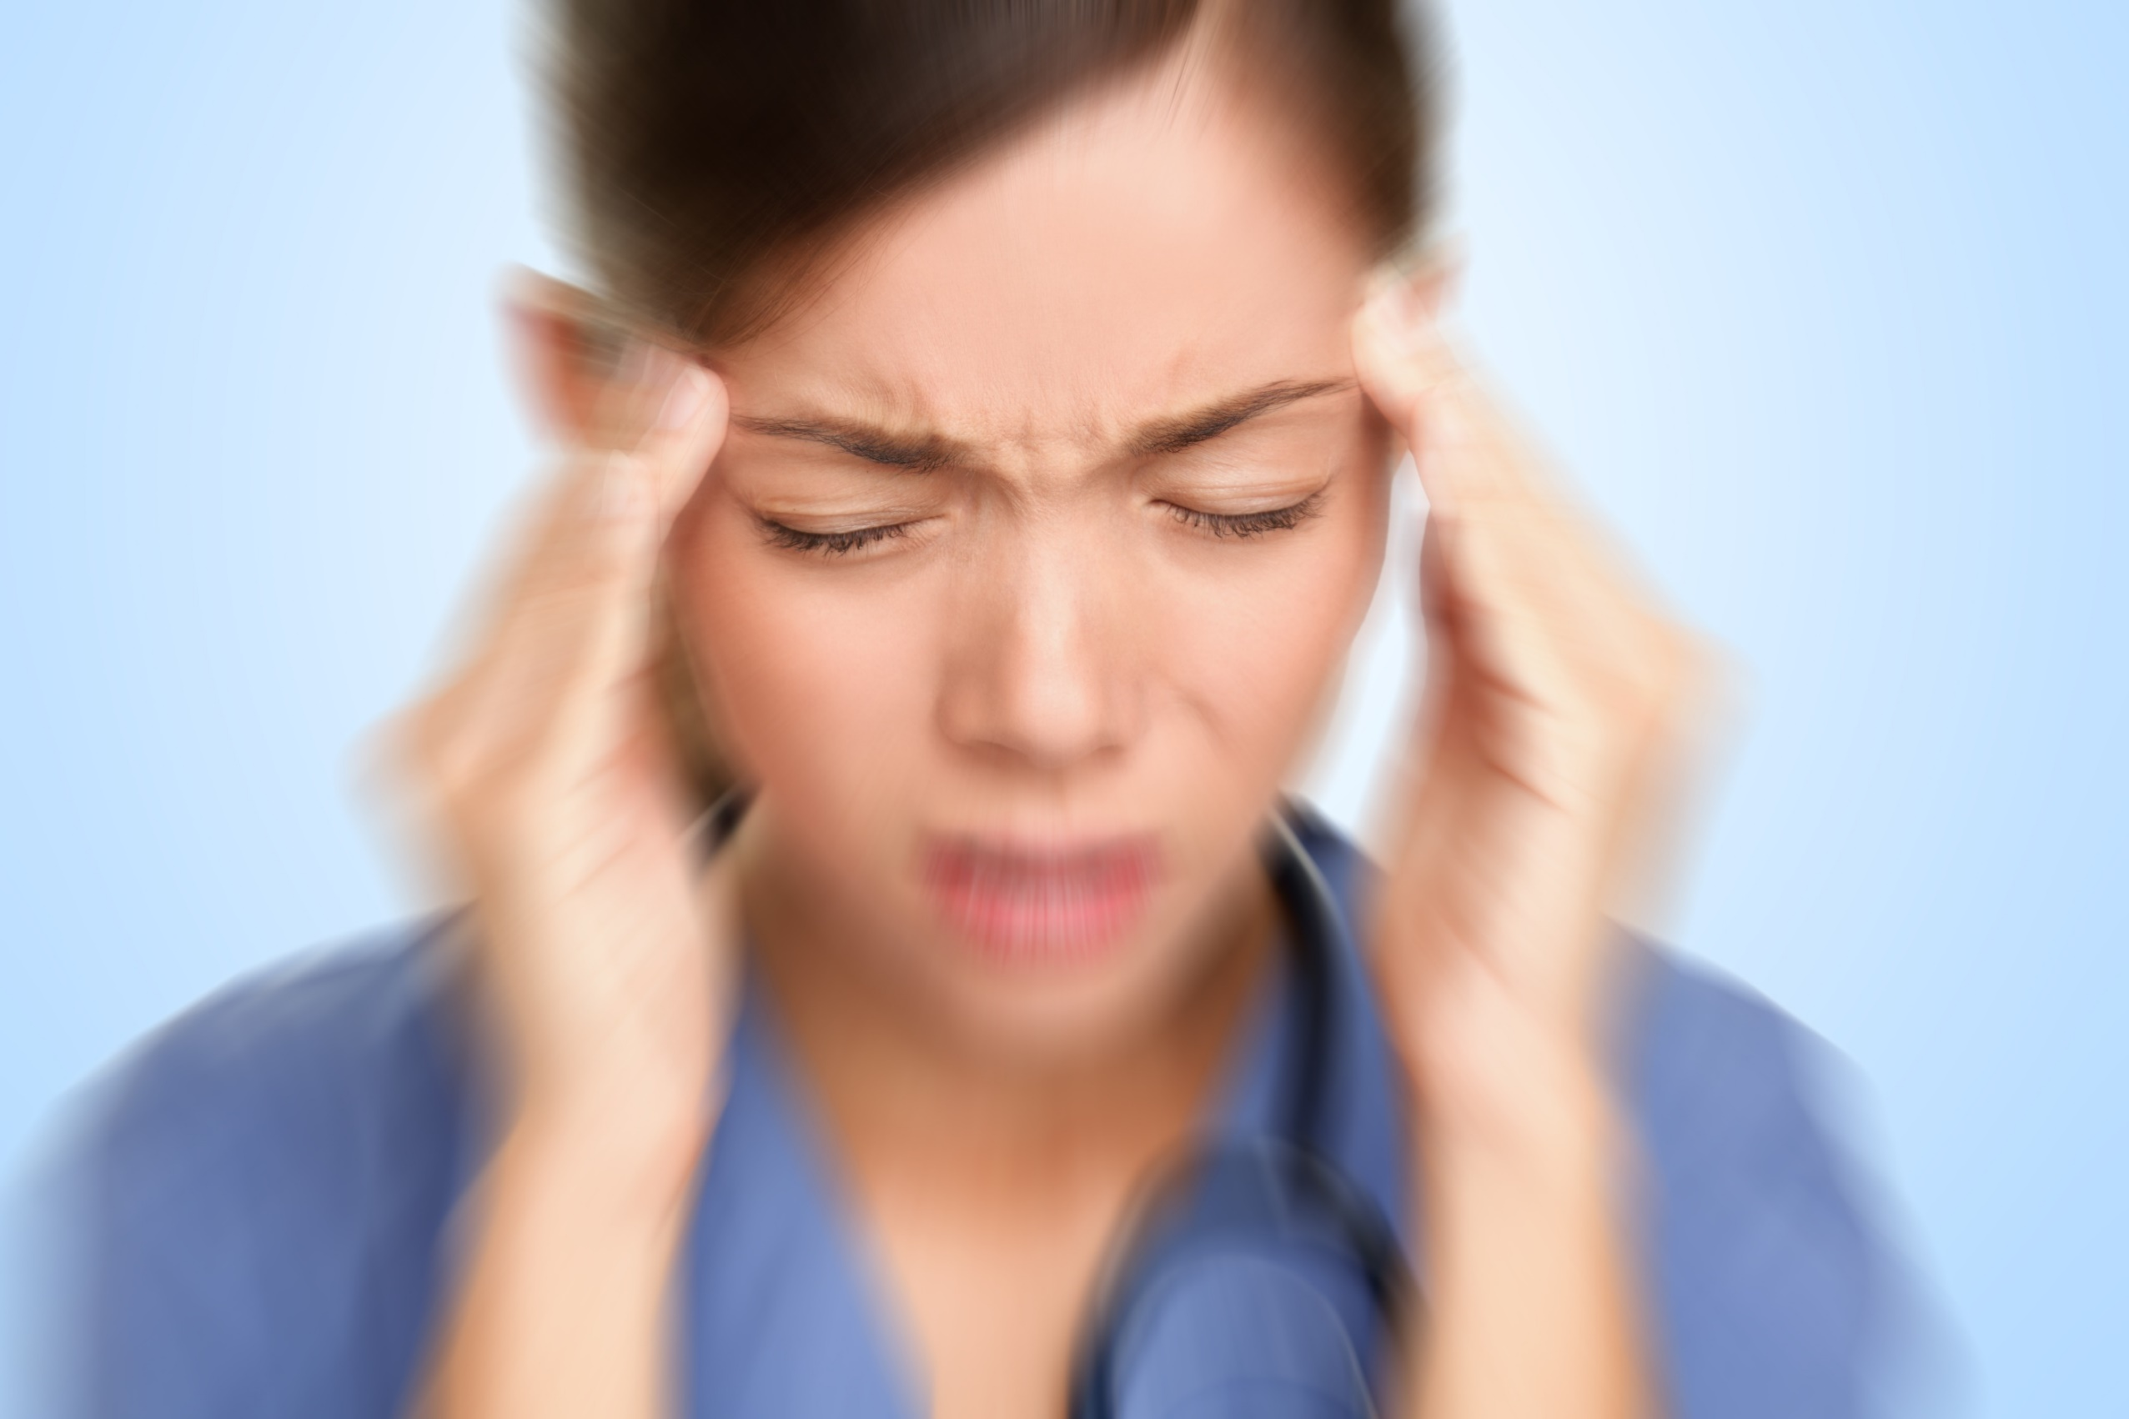
Migrainous Vertigo
Diagnostic Criteria
Episodic vestibular symptoms
Migraine according to the IHS criteria
At least one migrainous symptom during ≥2 vertigo attacks:
Migrainous headache
Photophobia
Phonophobia
Visual or other auras
Other causes ruled out by appropriate investigations
aka vestibular migraine (NOT the same as basilar migraine)
higher incidence of vertigo, travel-sickness, BPPV and Meniere’s in migraineurs
episodic vertigo in patients with a history of migraine or with other clinical features of migraine
episodes last seconds to days (≤72h) and may recur several times per day or only a few times every year
no other neurological symptoms, headache often absent
no confirmatory tests (diagnosis of exclusion)
acute migraine treatments (e.g. triptans), vestibular suppressants and prophylactic migraine therapy (e.g. β-blockers, TCAs) may be effective

Slide 22
Clinical Case 2
82-year-old female with T2DM, ARMD, cerebrovascular disease
Recurrent falls, now afraid to leave the house
Off-balance and ‘dizzy’ since attack of vestibular neuronitis 6m ago
Brief epsiodes of vertigo e.g. when crossing road or using escalators
No associated neurological symptoms, hearing loss or tinnitus
Started on betahistine by GP with no improvement
WHAT IS THE DIAGNOSIS?
WHAT IS THE TREATMENT?

Slide 23
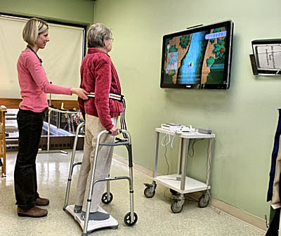
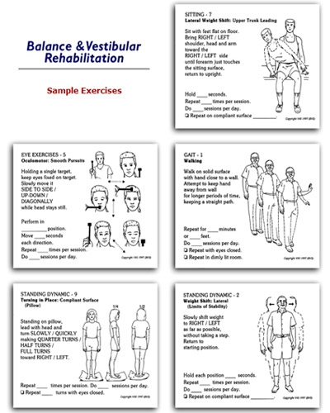
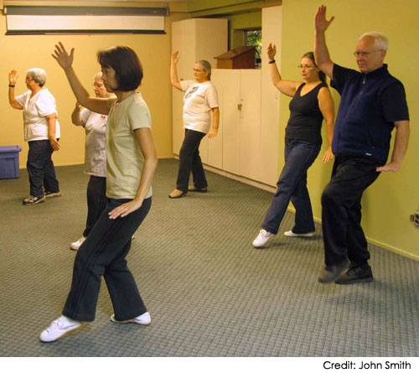
Uncompensated Vestibular Hypofunction
Failure of central compensation
Vestibular sedatives
Abnormal posturing
Visual impairment
Poly-pharmacy
Restriction of activity
Peripheral neuropathy
Anxiety and fear
Cognitive Impairment
Cerebral Pathology
Usually occurs following an acute unilateral peripheral vestibular insult
Vestibular neuronitis, Meniere’s disease, BPPV
Ototoxic medication, trauma, surgery
Failure (or absence) of central compensatory recalibration mechanisms
Persistent imbalance (dysequilibrium) and vague dizziness
Brief attacks of vertigo may occur
With sudden head movements
In visually ‘rich’ environments
Stop vestibular sedatives and optimize other sensory inputs
Vestibular Rehabilitation Therapy (VRT) is the cornerstone of Rx

Slide 24
Assessment of Vertigo: History
Clarify exactly what patient means by ‘dizziness’
Previous episodes , duration / frequency / triggers, normal in between attacks?
Associated symptoms
Recent viral URTI
Neurological
Tinnitus / hearing loss
Migrainous symptoms
PMHx esp. vascular risk factors, migraine, ENT
DHx esp. exposure to ototoxics, prolonged use of vestibular sedatives
When you say ‘dizzy’ do you mean light-headed, off-balance or are things moving around like you’ve just stepped off a roundabout?

Slide 25
Assessment of Vertigo: Examination
Lying and Standing BP and ECG are mandatory
Cardiovascular examination
FULL neurological examination including cranial nerves
Assessment of eye signs including nystagmus and head impulse test HINTS
Auroscopy
Watch the patient walk!
Dix-Hallpike test +/- Epley manoeuvre
MRI +/- DWI, CTA / MRA if RED FLAGS
Consider referral to audiometry, ENT, Neurology, Physiotherapy

Slide 26
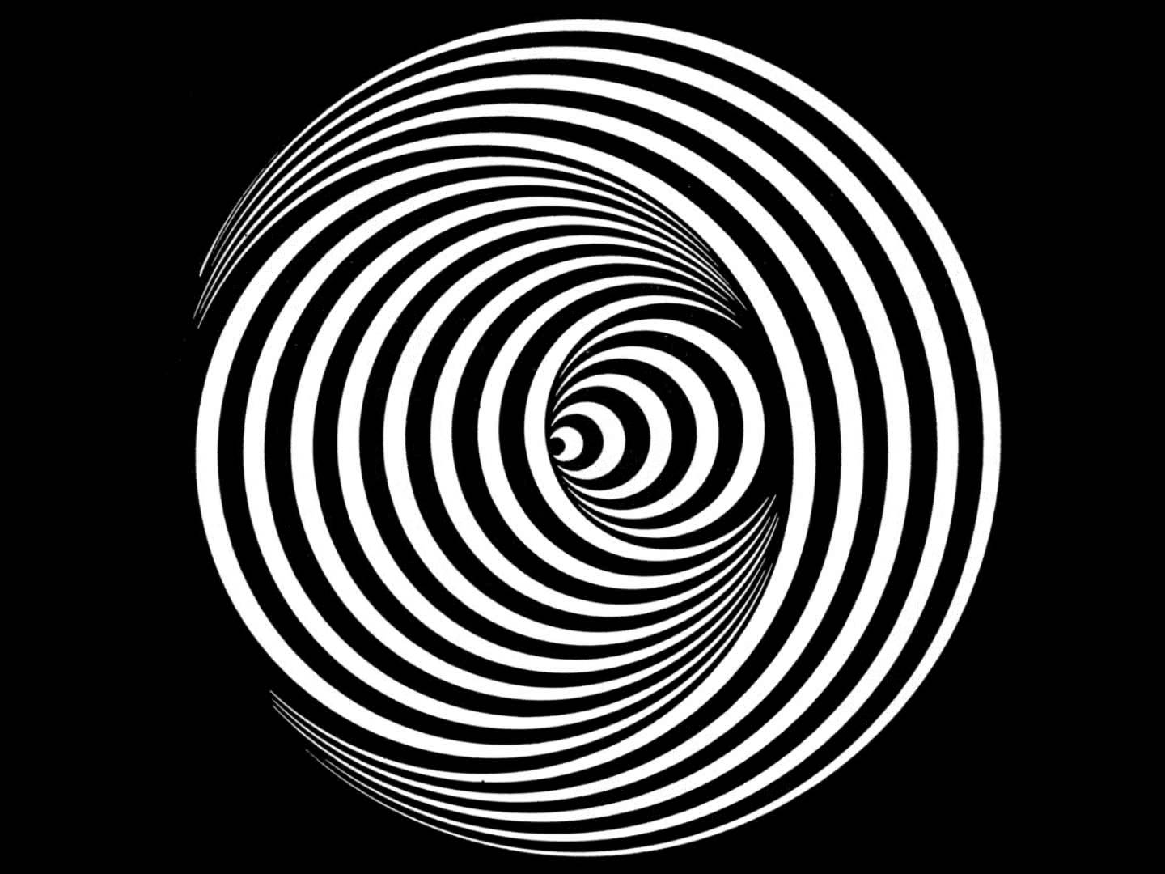
Questions?

