Slide 1
Sepsis
Dr Helen Dillon June 2017

Slide 2
Outline
Why is Sepsis important
Definitions of Sepsis
Screening for Sepsis
Sepsis Six

Slide 3



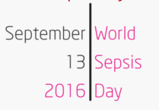
UK estimates:
150,000 cases per year in the UK
44,000 deaths per year – more than bowel, breast, and colon cancer combined
£2 billion cost to NHS each year
Lack of public awareness: 60% unaware of the term sepsis
Mortality of severe sepsis: 35%
(5x higher than STEMI and stroke)
Incidence of hospital admission due to sepsis has doubled in past 10 years
Global estimates:
27 million cases per year
8 million deaths
Common cause of maternal deaths
Long term complications: loss of physical function (53.5% in NCEPOD 2015), worsened cognitive state (19.7%), kidney injury/imparied kidney function (14.1%)

Slide 4
High Mortality
  35% for severe sepsis
Time Critical
  Every 1 hour delay in antibiotic administration = 8% increase in mortality
Under recognised
  NCEPOD – peer review of 551 case notes of patients seen by CCOT/admitted to ICU at a mix of hospitals nationwide, reviewed organisational, pre-hospital/GP, emergency care, and inpatient factors
  Key points from NCEPOD:
    Care less than “good” in 64% of cases
    Frequently attributed to delay in recognition and early treatment

Slide 5
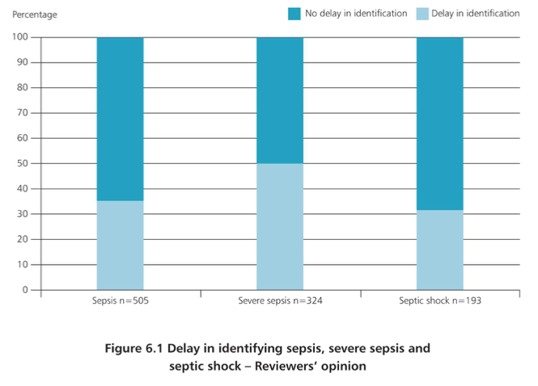

Slide 6

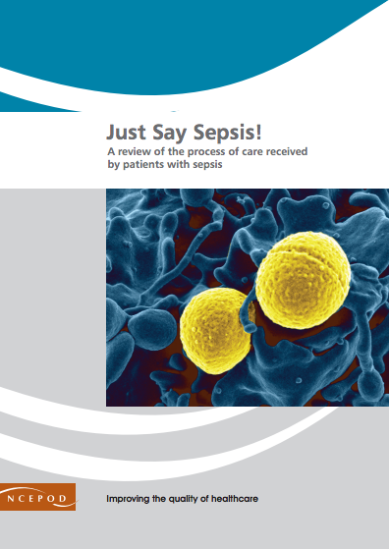
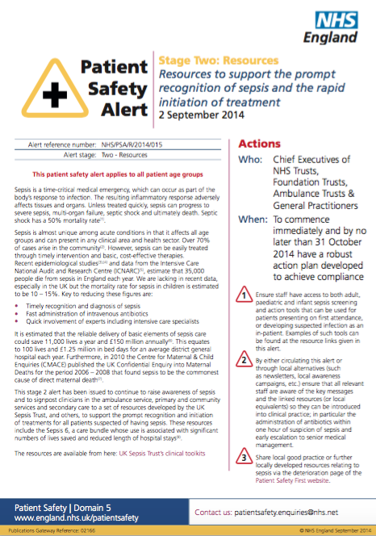

Slide 7
Organisational Importance
Sepsis cquinn
NICE guidance (July 2016)
Regional Sepsis Guideline (West Midlands)

Slide 8
What is Sepsis?

Slide 9
Sepsis is a life threatening condition that arises when the body’s response to an infection injures its own tissues and organs.
Sepsis leads to shock, multiple organ failure and death especially if not recognized early and treated promptly.
Sepsis can be caused by a huge variety of different bugs, most cases being caused by common bacteria.

Slide 10
Definitions of Sepsis
Sepsis – a clinical syndrome defined by the presence of both a suspected or confirmed infection and a systemic inflammatory response (SIRS)
Severe sepsis – sepsis with ≥1 organ dysfunction (excl. shock)
Septic shock – sepsis with hypotension refractory to adequate fluid resuscitation (SBP ≤90, MAP ≤65, or drop of >40 to usual SBP) / lactate ≥4
Multi organ dysfunction syndrome (MODS) – progressive organ deterioration; severe end of spectrum of disease for SIRS/sepsis

Slide 11
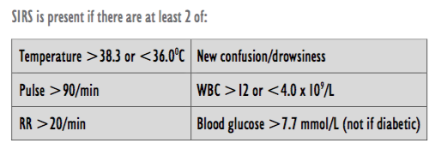
Definitions of Sepsis - SIRS
Systemic Inflammatory Response Syndrome (SIRS)

Slide 12
How can we improve recognition of Sepsis?
All patients found to have physiological disturbances that could meet SIRS criteria (e.g raised NEWS score) or with symptoms/signs compatible with infection should be screened for sepsis.
Suspicion of infection is all that is required.
Opportunities for recognition of sepsis
  Every obs round
  Every ward round
  Every handover
  During interventions e.g dressing changes
  When there is a change in a patients clinical condition
  On arrival to ward or prior to transfer to another area

Slide 13
Other markers of Sepsis
- Red Flag Sepsis
3 additional markers of severe sepsis
  AVPU of less than ‘Alert’
  HR >130bpm
  RR >25

Slide 14
Other markers of Sepsis
- Lactate
Lactate level in sepsis in highly predictive of death/poor outcome
Lactate | Mortality
<2 | 15%
2-4 | 25%
>4 | 38%

Slide 16
Initial Assesment
No current evidence of sepsis
Uncomplicated Sepsis
Severe sepsis
Septic Shock
For severe sepsis or septic shock – ‘SEPSIS SIX’
  Needs to be completed within 1 hour

Slide 18
Sepsis Six
Prospective study found Sepsis Six has an NNT of 4.6 in Severe Sepsis
  Compares to NNT of 42 for aspirin in ACS or 45-90 for PCI in STEMI
On diagnosis of sepsis patients should not be transferred to another clinical area until the ‘Sepsis Six’ is complete
After review by medical team there should be clear documentation including;
  Escalation decision & parameters
  Schedule for repeat lactate measurement and further medical review

Slide 19
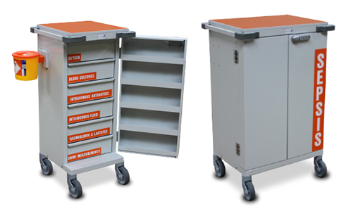
Supporting the‘Sepsis Six’
Outreach team
Abx prescriber sharing responsibility for administration
Sepsis trolley
Sepsis teams (larger trusts)

Slide 20
Ways to prevent in-hospital sepsis
Handwashing
Antimicrobial Stewardship
‘Right Line, Right Time’

Slide 21
Summary
High Mortality
Early Intervention Works
Recognition and Rapid Action are Key

